Slide 1
Introduction to Calculus

Slide 2

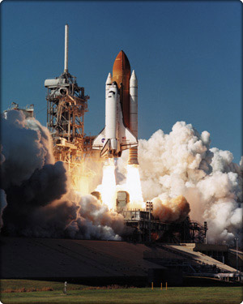

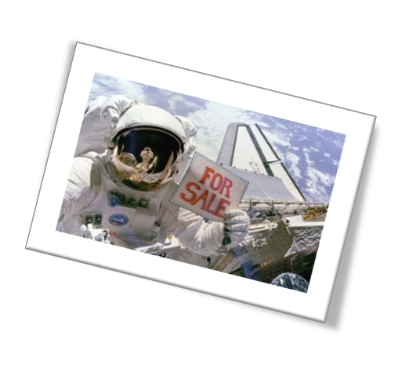
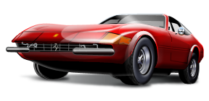
What Do You Think?
What things could be considered the greatest achievements of the human mind?

Slide 3
It's the Greatest!
Consider that all these things emerged because of technological advances
Those advances relied on CALCULUS !
Calculus has made it possible to:
  Build giant bridges
  Travel to the moon
  Predict patterns of population change

Slide 4
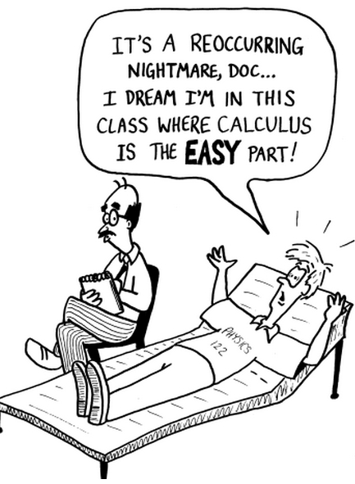

Slide 5
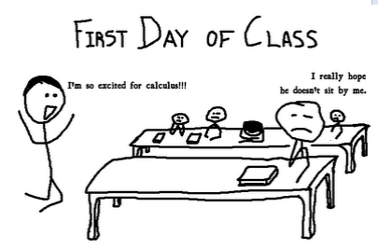

Slide 6

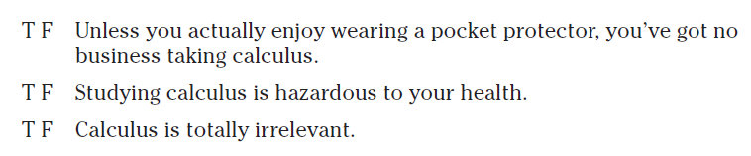


True or False?

Slide 7
The Genius of Calculus is Simple
It relies on only two ideas
  The Derivative
  The Integral
Both come from a common sense analysis of motion
  Motion is change in position over time
  All you have to do is drop your pencil to see it happen

Slide 8
What Is Calculus
It is the mathematics of change
It is the mathematics of
  tangent lines
  slopes
  areas
  volumes
It enables us to model real life situations
It is dynamic
  In contrast to algebra/precalc which is static

Slide 9
What Is Calculus
One answer is to say it is a "limit machine"
Involves three stages
  Precalculus/algebra mathematics process
    Building blocks to produce calculus techniques
  Limit process
    The stepping stone to calculus
  Calculus
    Derivatives, integrals

Slide 10
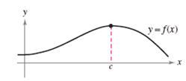
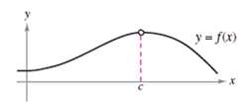
Contrasting Algebra & Calculus
Use f(x) to find the height of the curve at x = c
Find the limit of f(x) as x approaches c

Slide 11


Contrasting Algebra & Calculus
Find the average rate of change between
t = a and t = b
Find the instantaneous rate of change at t = c

Slide 12
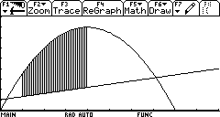
Contrasting Algebra & Calculus
Area of a rectangle
Area between two curves

Slide 13
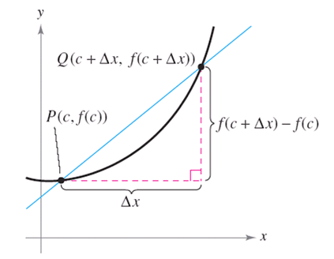
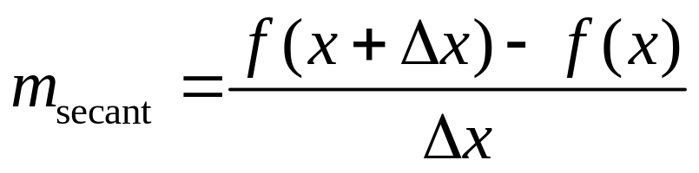
Tangent Line Problem
Approximate slope of tangent to a line
  Start with slope of secant line

Slide 14
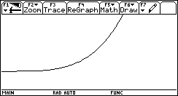
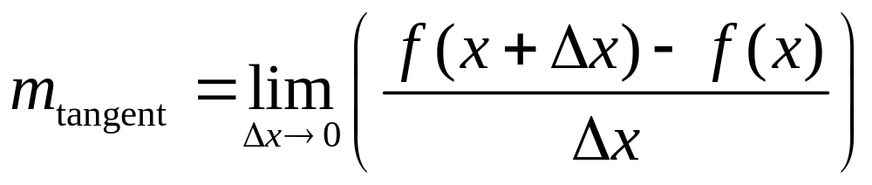
Tangent Line Problem
Now allow the Δx to get smaller

Slide 15
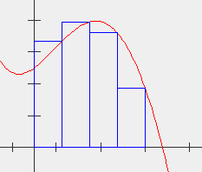
The Area Problem
We seek the area under a curve, the graph f(x)
We approximate
that area with
a number of
rectangles
Sum = 31.9
Actual = 33.33

Slide 16
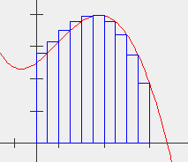
The Area Problem
The approximation is improved by increasing the number of rectangles
Number of
rectangles = 10
Sum = 32.92
Actual = 33.33

Slide 17
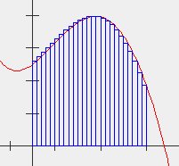
The Area Problem
The approximation is improved by increasing the number of rectangles
Number of
rectangles = 25
Sum = 33.19
Actual = 33.33
View Applet Example

Slide 18
Assignment
Lesson 2.1
Page 67
Exercises 1 – 10 all

